Slide 1

REVIEW PART II - CSS
Ranken Technical College

Slide 2
Objectives
Apply styles with Inline Styles, Embedded Stylesheets, and External Stylesheets
Understand the CSS Box Model
Use CSS Flexbox to implement page layouts
Use the main CSS selectors: type, class, id
Use CSS relational selectors: descendent and direct descendent
Use CSS properties to style text
Use CSS properties to change background and foreground colors

Slide 3
Applying Styles
Inline Styles, Embedded Stylesheets, and External Stylesheets

Slide 4
Inline Styles
Applies styles directly to an individual element.
Example
<h1 style="color: blue;">Blue h1</h1>
However, this is very poor style and should be avoided at all costs.
These styles have the highest precedence possible and cannot be overridden with a stylesheet.
They cannot be overridden responsively using media queries. (See first point.)
They cannot be re-themed. (See first point.)
They cause styling data to be scattered and duplicated across the application.

Slide 5
Embedded Stylesheets
Embedded stylesheets are generally placed in the <head> of the HTML document and are used to apply styles to a particular page.
Example
<style>
h1 { color: blue; }
</style>

Slide 6
External Stylesheets
External stylesheets are generally placed in a folder named css.
They are used to apply styles to an entire website.
In <head> of HTML document:
<link rel="stylesheet" href="/css/main.css">
In css/main.css:
h1 { color: blue; }

Slide 7
Box Model
Understanding the CSS box model.

Slide 8
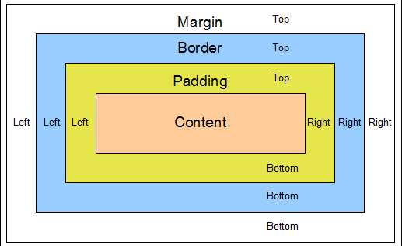
CSS Box Model

Slide 9
Definitions
Margin - Clears an area outside the border. The margin is always transparent.
Border - A border that goes around the content.
Padding - Clears an area between the border and the content.
Content - The content of the box, where text and images appear.
NOTE: Any background applied to the element is bounded to the border.
Notes:
https://developer.mozilla.org/en-US/docs/Web/CSS/box-sizing

Slide 10
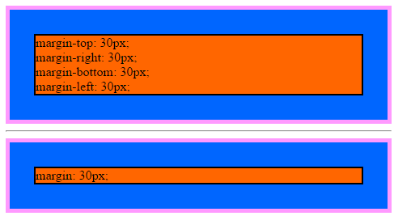
margin
The margin property sets the margin area on all four sides of an element.
It is a shorthand for margin-top, margin-right, margin-bottom, and margin-left.
TODO:
Add better example and image
Source
https://developer.mozilla.org/en-US/docs/Web/CSS/margin
Notes:
https://developer.mozilla.org/en-US/docs/Web/CSS/margin

Slide 11
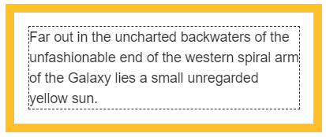
padding
The padding property sets the padding area on all four sides of an element.
It is a shorthand for padding-top, padding-right, padding-bottom, and padding-left.
TODO:
Add better example and image
Source
https://developer.mozilla.org/en-US/docs/Web/CSS/padding

Slide 12
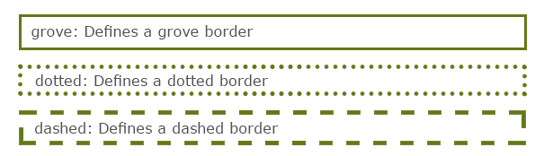
border
The border shorthand property sets an element's border.
It sets the values of border-width, border-style, and border-color.
TODO:
Add better example and image
Source
https://developer.mozilla.org/en-US/docs/Web/CSS/border

Slide 13
border-radius
TODO:
Add explanation of border-radius

Slide 14
background
TODO:
Add explanation of background

Slide 15
box-sizing
The box-sizing property sets how the total width and height of an element is calculated.
content-box
The width and height properties include the content, but do not include the padding, border, or margin.
For example, .box {width: 350px; border: 10px solid black;} renders a box that is 370px wide.
This is the default mode.
border-box
The width and height properties include the content, padding, and border, but do not include the margin.
For example, .box {width: 350px; border: 10px solid black;} renders a box that is 350px wide.
Using this mode for page layout is higly recommended.
Notes:
https://developer.mozilla.org/en-US/docs/Web/CSS/box-sizing

Slide 16
Flexbox
Using flexbox to implement page layouts.

Slide 17
What is Flexbox?
Flexbox is a one-dimensional layout model. It offers powerful space distribution and alignment capabilities not found in previous layout models.
Flexbox is the backbone of modern responsive web design.
Source
https://developer.mozilla.org/en-US/docs/Web/CSS/CSS_Flexible_Box_Layout/Basic_Concepts_of_Flexbox

Slide 18
TODO:
Add explanation of flexbox

Slide 19
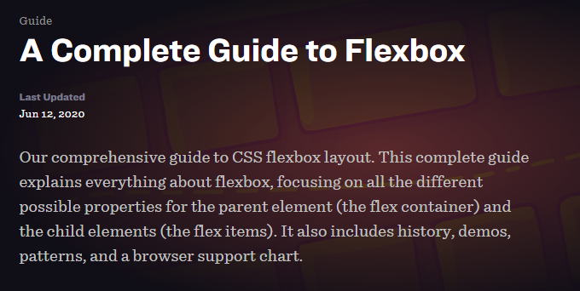
A Complete Guide to Flexbox
See https://css-tricks.com/snippets/css/a-guide-to-flexbox/
for a complete and thorough explanation of flexbox (with helpful pictures.)

Slide 20
CSS Selectors
Using selectors to pick what elements to style.

Slide 21
CSS Selectors
See the following URL for a complete list of all CSS Selectors:
https://developer.mozilla.org/en-US/docs/CSS/CSS_Reference

Slide 22
CSS Class Selector
The class attribute is used to point to a class name in a stylesheet. It can also be used by a JavaScript to access and manipulate elements with that name
Example:
.red {color: red;} (in CSS):
<p class="red">Red paragraph1</p>
<p class="red">Red paragraph2</p>

Slide 23
CSS ID Selector
The id attribute is used to point to an element in a stylesheet. It can also be used by a JavaScript to access and manipulate an element with that name
Example:
#red {color: red;} (in CSS):
<p id="red">Red paragraph1</p>

Slide 24
CSS Selector Categories
Simple Selectors select based on element name, id, or class name
Example:
p {
text-align: center;
color: red;
}
Source
https://www.w3schools.com/CSS/css_selectors.asp

Slide 25
CSS Selector Categories
A combinator selects based upon the relationship between the selectors
Types:
descendant selector (space)
child selector (>)
adjacent sibling selector (+)
general sibling selector (~)
Source
https://www.w3schools.com/CSS/css_combinators.asp

Slide 26
CSS Selector Categories
A pseudo-class selects based on a special state of an element
Types (must be listed in this order to work):
link
visited
hover
active
Source
https://www.w3schools.com/css/css_pseudo_classes.asp

Slide 27
CSS Selector Categories
A CSS pseudo-element is used to style specified parts of an element
Types:
::after Inserts after element
::before Inserts before element
::first-letter Selects first letter
::first-line Selects first line
::selection Selects portion of an element
Source
https://www.w3schools.com/CSS/css_pseudo_elements.asp

Slide 28
CSS Selector Categories
A CSS attribute selector selects elements with a specified attribute
Types:
[attribute]
[attribute=value]
[attribute~=value]
[attribute|=value]
Source
https://www.w3schools.com/CSS/css_attribute_selectors.asp

Slide 29
CSS Selector Categories
A CSS attribute selector selects elements with a specified attribute
Types:
[attribute^=value]
[attribute$=value]
[attribute*=value]
Source
https://www.w3schools.com/CSS/css_attribute_selectors.asp

Slide 30
CSS Colors
CSS3 supports the "old" hexadecimal format for colors, and the rgb() (red, green, blue) format, and the built-in colors
In addition, CSS supports the following color options:
RGBA
HSL
HSLA

Slide 31
CSS Colors
HSL stands for hue, saturation, and lightness. hsl() accepts three values:
hue in degrees from 0 – 359
saturation, as a % where 100% is full hue and 0% causes a shade of gray
percentage for lightness, where 100% is white, 0% is black, and 50% is the norm
Source
https://www.w3schools.com/CSS/css_attribute_selectors.asp

Slide 32
CSS Box-Shadow
The CSS3 box-shadow property takes a comma-separated list of shadows as its value. Each shadow includes a color and:
The horizontal offset
The vertical offset
The blur distance of the shadow
The spread distance of the shadow
Source
https://www.w3schools.com/CSSref/css3_pr_box-shadow.asp

Slide 33
CSS Gradients
CSS Radial Gradients are circular or elliptical gradients. The colors blend out from a starting point in all directions
CSS Linear Gradients are those where colors transition across a straight line, from top to bottom, left to right, or along any arbitrary axis
CSS Repeating Gradients provides both a repeating-linear-gradient and a repeating-radial-gradient gradient
Source
https://developer.mozilla.org/en-US/docs/CSS/Using_CSS_gradients

Slide 34
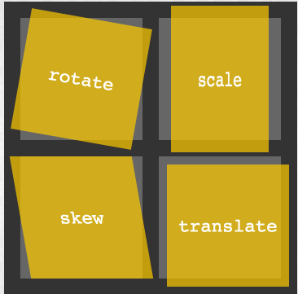
CSS Transforms
The CSS transform property lets the user translate, rotate, scale, or skew an page element. Translation functions let the user move elements left, right, up, or down
Source
https://developer.mozilla.org/en-US/docs/CSS/Tutorials/Using_CSS_transforms

Slide 35

CSS Transitions
Transitions allow the values of CSS properties to change over time, in essence providing simple animations
Source
https://developer.mozilla.org/en-US/docs/CSS/Tutorials/Using_CSS_transforms

Slide 36

CSS Animations
CSS animations involve the use of keyframes, i.e. a snapshot that defines a start/end point of a smooth transition
Source
https://developer.mozilla.org/en-US/docs/Web/CSS/CSS_Animations/Using_CSS_animations

Slide 37
What We Covered
The 3 CSS Types
The CSS Box Model
CSS Flexbox
CSS Grid Layout
The Main CSS Selectors
The CSS Relational Selector

Slide 38
What We Covered
The Use Of CSS3 and Colors
CSS3 Box-Shadow
CSS3 Gradients
CSS3 Transforms
CSS3 Transitions
CSS3 Animations

Slide 39
Some Useful URLs
https://developer.mozilla.org/en-US/docs/Web/CSS/Reference
https://developer.mozilla.org/en-US/docs/Learn/CSS/First_steps
https://www.w3schools.com/Css/

